Slide 1

Music DB
Presented By:
Swaraj Rath – 11012467
Adarsh Mayya Devashya – 11012460
Rakshit Siddalingappa – 11012530
Jeevan Sira Manjunath – 11012455
Ankush Akshay Hassan - 11012529
Supevisor:
Prof. Dr. Barbara Sprick
Mr. Frank Hefter

Slide 2
Table of contents
Introduction
MongoDB
Redis
Neo4j
Data Model
User Stories
Conclusion

Slide 3

Introduction
Now a days many music lovers have accumulated collections of music that have reached sizes that make it hard to maintain an overview of the data by just browsing hierarchies of folders.
Search methods based on song similarity offer an alternative, allowing users to abstract from manually assigned metadata, such as, frequently imprecise or incorrect, genre information.
The purpose of this project is to design and develop data models across multiple types of databases in order to provide a smooth experience to the user as well as admin of this app allowing multiple levels of data granularity
Notes:
In a context where music collections grow and change rapidly, the similarity-based organization has also the advantage of providing easy navigation and retrieval of new items, even without knowing songs by name.
ACID Property

Slide 4
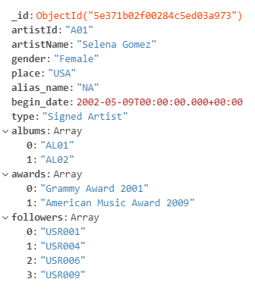
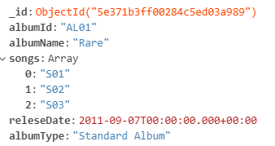
MongoDB
MongoDB
MongoDB is a document oriented open-source database where all the data is stored in this database owing to its variety (heterogeneous data), scalability and value.
In MongoDB we can ﬁnd multiple operators that allow us to create powerful queries (songs, artist, and release date),which can return a speciﬁc ﬁeld in a document, or a JavaScript function deﬁned by the user.
We choose to dump huge chunks of data in MongoDB which would be the main information and other files which the user is looking for owing to the mass data holding capacity of MongoDB in the form of JSON.
Store all detailed information for all entities
Notes:
High amount of unstructured data at high speed, scalable and reliable
ACID – Atomicity, Consistency, Isolation, Durability, transaction between multiple collection even if the power failue.

Slide 5
Redis
Redis
-> List Name: A01(Selena Gomez)
Lpush A01 USR001 USR004 USR006 USR009
-> List Name: A02 (Marshmello)
Lpush A02 USR002 USR003 USR004 USR007
-> List Name: A03 (Maroon 5)
Lpush A03 USR003 USR004 USR009 USR011
-> List Name: A04 (Katy Perry)
Lpush A04 USR005 USR006 USR007
-> List Name: A05 (Shakira)
Lpush A05 USR005 USR006 USR007
Redis is a popular and very fast in-memory database structure store primarily used as a cache or a message broker. It stores data in the form of key-value, list and sets.
Redis is used mainly because of its speed and for large volume of data being access concurrently by many users. Such as in the case of likes in a song or followers of artist where large number of data are constantly being inserted onto the database.
Store all information about the followers of a artist and likes in song.
Notes:
Remote Dictionary Server
Asynchronous Replication - requests can be split among the servers provides improvement performance and faster recovery

Slide 6
Neo4j
Neo4j
Albums
Artist Type
Neo4j is a graph database management system, which is another type of NoSQL database which provides better performance for highly related data. Such graph databases are best suited for today’s agile and test-driven development practices.
Neo4j uses labeled graphs, meaning that each node have one or more string assigned that defines the node.
Artist
HAS
Albums
Album Name
Songs
CONTAINS
Songs
Song Name
Song Type
Store all relationships between all entities
Notes:
A graph is composed by 2 elements: nodes (or vertices) and edges. A node represents an entity (like a person, institution, thing, or category) and the edges represent how the nodes are related to each other
Relationship type

Slide 7
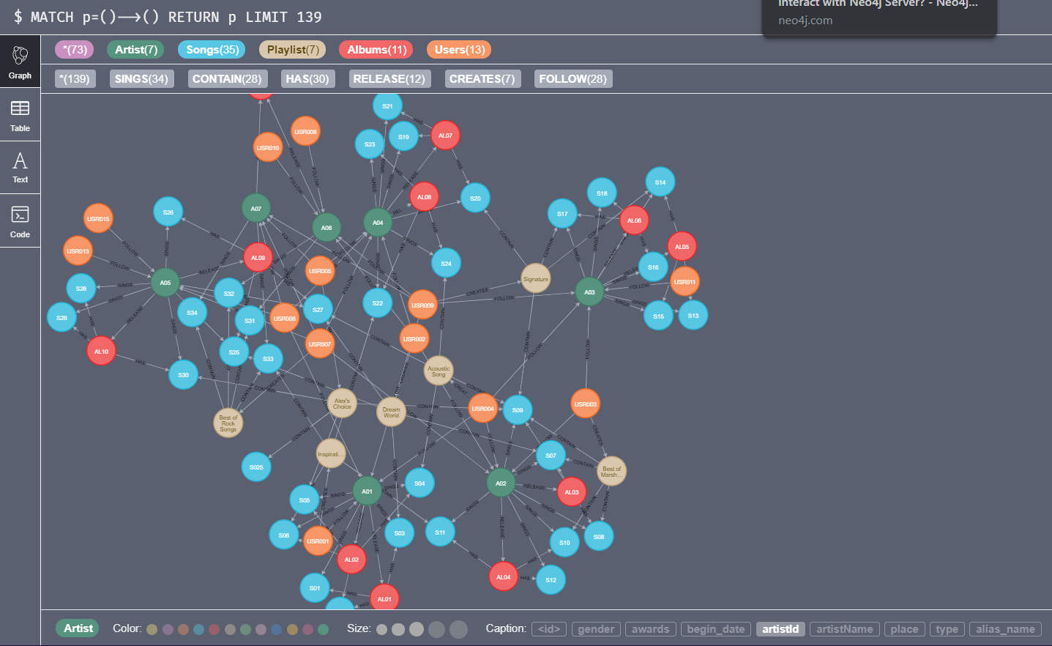

Slide 8
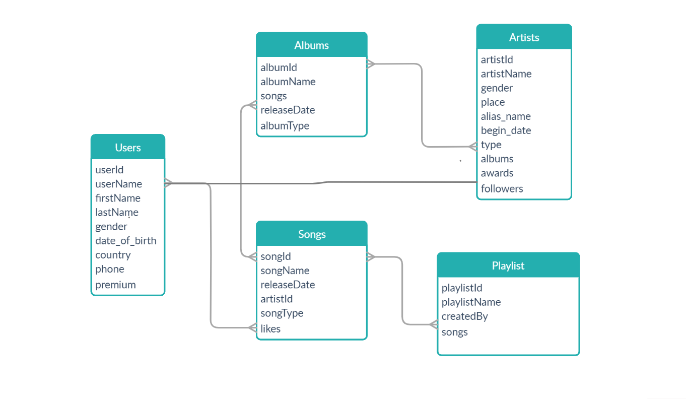
Data Model

Slide 9
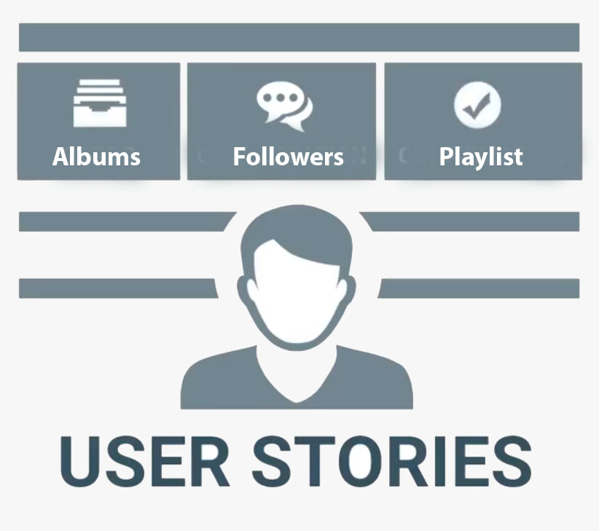
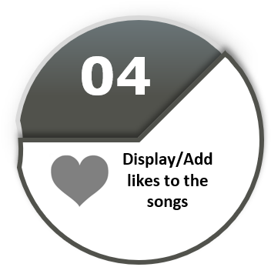

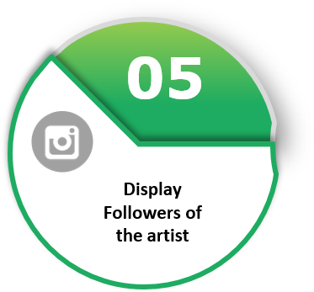
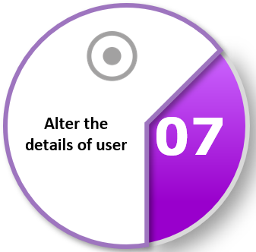
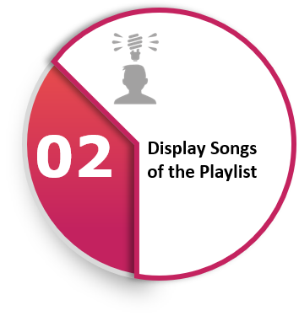
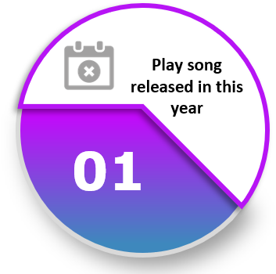
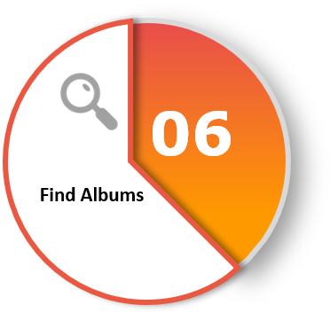
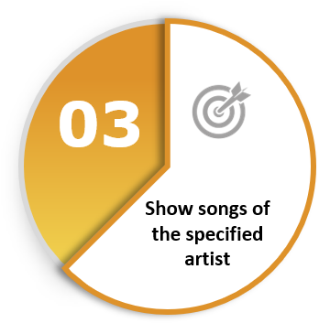
0
07
06

Slide 10

Display song released in Certain Year
As a end user I would like to know the songs released in between the year
db.songs.find({releseDate: {
$gte: ISODate("2015-01-01T00:00:00.000Z"),
$lt: ISODate("2016-01-01T00:00:00.000Z")}}).pretty()
As a end user I would like to know old songs.
db.songs.find({releseDate: {
$lt: ISODate("2016-01-01T00:00:00.000Z")}})
MongoDB
Redis
Neo4j

Slide 11
Display songs inside a playlist
As a end user I would like to know the songs inside the Playlist
match (p:Playlist{playlistId:"PLY005"})-[co:CONTAIN]->(s:Songs)
return s.artistId,s.songId, s.songName
As a end user I would like to know who created the Playlist
match (u:Users)-[c:CREATES]->(p:Playlist{playlistName:"Best of Rock Songs"})
return u.userId,u.userName, p.playlistId
MongoDB
Redis
Neo4j

Slide 12
Show songs of a specific Artist
As a end user I would like to know the songs of the Artist.
match (a:Artist{artistId: "A05"})-[f:SINGS]->(s:Songs)
return a.artistName, s.songId, s.songName
As a end user I would like songs according to country of artist.
match (a:Artist{place:"Spain"})-[so:SINGS]->(s:Songs) return a.artistName, s.songId, s.songName
As a end user I would like playlist contains certain songs.
match (p:Playlist{playlistId:"PLY005"})-[co:CONTAIN]->(s:Songs) return s.artistId,s.songId, s.songName
MongoDB
Redis
Neo4j

Slide 13
Display/Add likes to the song
As a end user I would like to display the likes of a Song
Lrange S01 0 -1
As a end user I would like to display number of likes of a Song
Llen S01
As a end user would like to like a Song.
Lpush S01 USR024
MongoDB
Redis
Neo4j

Slide 14
Display follower of an Artist
As a end user I would like to display the followers of a artist.
Lrange A01 0 -1
As a end user I would like to display number of followers of a artist.
Llen A01
As a end user would like to follow an Artist
Lpush A01 USR023
MongoDB
Redis
Neo4j

Slide 15
Find Albums
As a end user I would like to search an album
db.albums.find({albumName:"Revival"}).pretty()
As a end user I would like to display the Albums of an Artist
match (a:Artist{artistName:"Adam Levine"})-[f:RELEASE]->(ab:Albums) return a.artistName, ab.albumId, ab.albumName
As a end user I would like to display songs inside an album
match (a:Albums{albumId: "AL05"})-[h:HAS]->(s:Songs) return a.albumName, s.songId, s.songName
MongoDB
Redis
Neo4j

Slide 16
Alter the details of the user
As a end user I would like to change my details.
db.users.update({userId: "USR014"},{$set: {lastName: "wolf"}})
db.users.insert({userId: "USR016“, firstName: “Adriana”, lastName: “Lopez”, gender: “Female”, date_of_birth: new Date(1991-08-05), country: “Monaco”, phone: “87654567890”, premium: false}})
As a end user I would like to register an account.
MongoDB
Redis
Neo4j

Slide 17
Admin Functionalities
As a admin I would like to add Songs to the Database.
db.songs.insert({songId:“S31“, songName: “What Lovers Do”, releseDate: new Date(“2017-08-30”), artistId: “A03”, songType: “Pop”})
As a admin I would like to add Albums to the Database.
db.albums.insert({albumId:“AL31“, albumName: “Joy Time”, songs: [“S31”, “S32”, “S33”], releaseDate: new Date(“2017-08-30”), albumType: “Pop”})
As a admin I would like to add Artist to the Database.
db.artists.insert({artistId:“A13“, artistName: “Ed Sheeran”, gender: “Male”, place: “USA”, alias_name: “”, begin_date: new Date(“2004-03-12”), type: “Signed Artist”, albums: [“AL22”, “AL23”], followers: [“USR003”, “USR008”]
MongoDB
Redis
Neo4j

Slide 18



Conclusion
MongoDB – Suppots Object Oriented Programming, JSON & BSON documents.
Neo4J – Native Graph Database, Convincible to show Relations.
Redis – Makes transactions faster, 1.2 Million requests per second.

